Slide 1
CS7015 (Deep Learning): Lecture 4
Feedforward Neural Networks, Backpropagation
Mitesh M. Khapra
Department of Computer Science and Engineering Indian Institute of Technology Madras
CS7015 (Deep Learning): Lecture 4

Slide 2
Module 4.1: Feedforward Neural Networks (a.k.a. multilayered network of neurons)
CS7015 (Deep Learning): Lecture 4

Slide 3
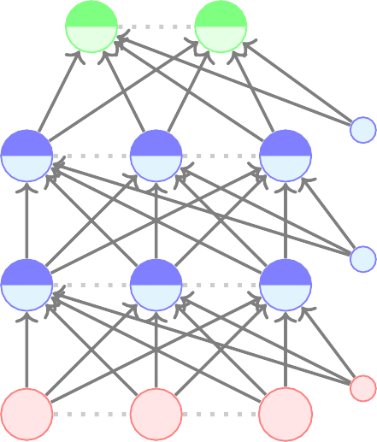
The input to the network is an n-dimensional vector
h_{L} = yˆ = f (x)
The network contains L − 1 hidden layers (2, in
a₃
this case) having n neurons each
Finally, there is one output layer containing k
neurons (say, corresponding to k classes)
Each neuron in the hidden layer and output layer can be split into two parts : pre-activation and
b₂ activation (a_{i} and h_{i} are vectors)
The input layer can be called the 0-th layer and the output layer can be called the (L)-th layer
W_{i} ∈ R^{n×n} and b_{i} ∈ R^{n} are the weight and bias between layers i − 1 and i (0 < i < L)
W₃
b₃
h
2
a₂
W₂
h
1
a₁
W₁
b₁
x
x
x
W_{L} ∈ R^{n×k} and b_{L} ∈ R^{k} are the weight and bias
1
2
n
between the last hidden layer and the output layer
(L = 3 in this case)
CS7015 (Deep Learning): Lecture 4

Slide 4

The pre-activation at layer i is given by
h_{L} = yˆ = f (x)
a_{i}(x) = b_{i} + W_{i}h_{i−1}(x)
The activation at layer i is given by
a₃
W₃
b₃
h₂
h_{i}(x) = g(a_{i}(x))
a₂
where g is called the activation function example, logistic, tanh, linear, etc.)
The activation at the output layer is given by
(for
W₂
b₂
h
1
a₁
f (x) = h_{L}(x) = O(a_{L}(x))
W₁
b₁
where O is the output activation function (for example, softmax, linear, etc.)
To simplify notation we will refer to a_{i}(x) as a_{i}
x₁
x₂
x_{n}
and h_{i}(x) as h_{i}
CS7015 (Deep Learning): Lecture 4

Slide 5
h_{L} = yˆ = f (x)
The pre-activation at layer i is given by
a_{i} = b_{i} + W_{i}h_{i−1}
The activation at layer i is given by
a₃
W₃
b₃
h₂
h_{i} = g(a_{i})
a₂
where g is called the activation function example, logistic, tanh, linear, etc.)
The activation at the output layer is given by
(for
W₂
b₂
h
1
a₁
f (x) = h_{L} = O(a_{L})
W₁
b₁
where O is the output activation function (for example, softmax, linear, etc.)
x₁
x₂
x_{n}
6/9
CS7015 (Deep Learning): Lecture 4

Slide 6
h_{L} = yˆ = f (x)
N
i=1
Data: {
x , y }
i i
Model:
a₃
W₃
yˆ_{i} = f (x_{i}) = O(W₃g(W₂g(W₁x + b₁) + b₂) + b₃)
b
3
h₂
Parameters:
θ = W₁, .., W_{L}, b₁, b₂, ..., b_{L}(L = 3)
a₂
W₂
b₂
Algorithm: Gradient Descent with propagation (we will see soon)
Objective/Loss/Error function: Say,
Back-
h
1
a₁
N k
1
N
Σ Σ
W₁
b₁
min
(yˆ − y
₎2
ij
ij
i=1 j=1
x₁
x₂
x_{n}
In general, min L (θ)
where L (θ) is some function of the parameters
7/9
CS7015 (Deep Learning): Lecture 4

Slide 7
Module 4.2: Learning Parameters of Feedforward Neural Networks (Intuition)
CS7015 (Deep Learning): Lecture 4

Slide 8
The story so far...
We have introduced feedforward neural networks
We are now interested in finding an algorithm for learning the parameters of this model
CS7015 (Deep Learning): Lecture 4

Slide 9

h_{L} = yˆ = f (x)
Recall our gradient descent algorithm
Algorithm: gradient descent()
a₃
t ← 0;
W₃
b₃
max iterations ← 1000;
h
2
Initialize w₀, b₀;
while t++ < max iterations do
a₂
w_{t+1} ← w_{t} − η∇w_{t};
W₂
b₂
b_{t+1} ← b_{t} − η∇b_{t};
h
1
end
a₁
W₁
b₁
x₁
x₂
x_{n}
CS7015 (Deep Learning): Lecture 4

Slide 10
Recall our gradient descent algorithm We can write it more concisely as
h_{L} = yˆ = f (x)
a₃
Algorithm: gradient descent()
W₃
b₃
t ← 0;
h
2
max iterations ← 1000;
Initialize θ₀ = [w₀, b₀];
while t++ < max iterations do
a₂
W₂
b₂
θ_{t+1} ← θ_{t} − η∇θ_{t};
h
1
end
where ∇θ =
∂L (θ) ∂L (θ) T
a₁
t
,
∂wt ∂bt
W₁
b₁
Now, in this feedforward neural network,
instead of θ = [w, b] we have θ = [W₁, W₂, .., W_{L}, b₁, b₂, .., b_{L}]
We can still use the same algorithm for learning the parameters of our model
x₁
x₂
x_{n}
CS7015 (Deep Learning): Lecture 4

Slide 11
h_{L} = yˆ = f (x)
Recall our gradient descent algorithm We can write it more concisely as
a₃
Algorithm: gradient descent()
W₃
b₃
t ← 0;
h
2
max iterations ← 1000;
Initialize θ₀ = [W ⁰, ..., W ⁰, b⁰, ..., b⁰ ];
1 L 1 L
a₂
while t++ < max iterations do
W₂
b₂
θ_{t+1} ← θ_{t} − η∇θ_{t};
h
1
end
where ∇θ =
∂L (θ) ∂L (θ) ∂L (θ)
∂W1,t ∂WL,t ∂b1,t
∂L (θ)
∂bL,t
T
a₁
t
, ., , , .,
W₁
b₁
Now, in this feedforward neural network,
instead of θ = [w, b] we have θ = [W₁, W₂, .., W_{L}, b₁, b₂, .., b_{L}]
We can still use the same algorithm for learning the parameters of our model
x₁
x₂
x_{n}
CS7015 (Deep Learning): Lecture 4

Slide 12
Except that now our ∇θ looks much more nasty
 ∂L (θ)
∂L (θ)
∂L (θ)
∂L (θ)
∂L (θ)
∂L (θ)
∂L (θ) ∂L (θ)
∂L (θ) 
. . .
. . .
. . .
. . .
. . .
∂W111 | ∂W11n | ∂W211 | ∂W21n | ^{∂W}L,11 | ^{∂W}L,1k | ^{∂W}L,1k | ∂b11 | ∂b_{L1}
 | . . ∂L (θ) | ∂L (θ) . | . . ∂L (θ) . | . . ∂L (θ) . . . ∂L (θ) |  | ∂L (θ) | ∂L (θ) . . . ∂L (θ)

∂L (θ)
.


∂W
121
∂W12n
∂W221
∂W22n
^{∂W}L,21
^{∂W}L,2k ^{∂W}L,2k
. .
.
∂L (θ)
^{∂W}L,nk
∂b12
∂b
L2


. . .
. . . . . .
. . .


. . .
. . . . . .
.
. . .
∂L (θ)
∂W1n1
∂L (θ) ∂L (θ)
∂L (θ)
∂W2nn
∂L (θ) . . .
∂L (θ) ∂L (θ)
∂L (θ)
∂b_{Lk}
. . .
. . .
. . .
. . .
∂W1nn ∂W2n1
^{∂W}L,n1
^{∂W}L,nk
∂b1n
∇θ is thus composed of
∇W₁, ∇W₂, ...∇W_{L−1} ∈ R^{n×n}, ∇W_{L} ∈ R^{n×k},
∇b₁, ∇b₂, ..., ∇b_{L−1} ∈ R^{n} and ∇b_{L} ∈ R^{k}
CS7015 (Deep Learning): Lecture 4

Slide 13
We need to answer two questions
How to choose the loss function L (θ)? How to compute ∇θ which is composed of
∇W₁, ∇W₂, ..., ∇W_{L−1} ∈ R^{n×n}, ∇W_{L} ∈ R^{n×k}
∇b₁, ∇b₂, ..., ∇b_{L−1} ∈ R^{n} and ∇b_{L} ∈ R^{k} ?
CS7015 (Deep Learning): Lecture 4

Slide 14
Module 4.3: Output Functions and Loss Functions
CS7015 (Deep Learning): Lecture 4

Slide 15
We need to answer two questions
How to choose the loss function L (θ) ? How to compute ∇θ which is composed of:
∇W₁, ∇W₂, ..., ∇W_{L−1} ∈ R^{n×n}, ∇W_{L} ∈ R^{n×k}
∇b₁, ∇b₂, ..., ∇b_{L−1} ∈ R^{n} and ∇b_{L} ∈ R^{k} ?
CS7015 (Deep Learning): Lecture 4

Slide 16
The choice of loss function depends on the problem at hand
y_{i} = {7.5
imdb Rating
8.2
Critics Rating
7.7}
RT
Rating
We will illustrate this with the help of two examples
Consider our movie example again but this time we are interested in predicting ratings
Here y_{i} ∈ R³
The loss function should capture how much yˆ_{i} deviates from y_{i}
Neural network with
L − 1 hidden layers
If y_{i} ∈ R^{n} then the squared error loss
can capture this deviation
isActor Damon
N 3
isDirector
1
Σ Σ
. .
. . . . . . . .
L (θ) =
(yˆ − y
₎2
Nolan
N
ij
ij
x_{i}
i=1 j=1
CS7015 (Deep Learning): Lecture 4

Slide 17

h_{L} = yˆ = f (x)
A related question: What should the output function ‘O’ be if y_{i} ∈ R?
More specifically, can it be the logistic function?
a₃
W₃
b
h₂
3
No, because it restricts yˆ to a value
i
between 0 & 1 but we want yˆ_{i} ∈ R
So, in such cases it makes sense to have ‘O’ as linear function
a₂
W₂
b₂
h
1
f (x) = h_{L} = O(a_{L})
= W_{O}a_{L} + b_{O}
a₁
W₁
b₁
yˆ = f (x ) is no longer bounded
i i
x₁
x₂
x_{n}
between 0 and 1
CS7015 (Deep Learning): Lecture 4

Slide 18

Notice that y is a probability distribution
0]
Banana
y = [1
Apple
0 0
Mango Orange
Therefore we should also ensure that
yˆ is a probability distribution
What choice of the output activation ‘O’ will ensure this ?
a_{L} = W_{L}h_{L−1} + b_{L}
Neural network with
L − 1 hidden layers
_{e}ªL,j
yˆ_{j} = O(a_{L})_{j} =
Σ
k i=1
_{e}ªL,i
O(a_{L})_{j} is the j^{th} element of yˆ and a_{L,j}
is the j^{th} element of the vector a_{L}.
This function is called the softmax
function
CS7015 (Deep Learning): Lecture 4

Slide 19
Now that we have ensured that both y & yˆ are probability distributions can you think of a function which
0]
Banana
y = [1
Apple
0 0
Mango Orange
captures the them?
Cross-entropy
difference between
Neural network with
L − 1 hidden layers
k
Σ
L (θ) = − y log yˆ
c c
c=1
Notice that
y_{c} = 1 if c = l (the true class label)
= 0 otherwise
∴ L (θ) = − log yˆ_{l}
CS7015 (Deep Learning): Lecture 4

Slide 20

So, for classification problem (where you have to choose 1 of K classes), we use the following objective function
h_{L} = yˆ = f (x)
a₃
minimize
θ
maximize
θ
L (θ) = − log yˆ_{l}
— L (θ) = log yˆ_{l}
W₃
b₃
h₂
or
But wait!
Is yˆ_{l} a function of θ = [W₁, W₂, ., W_{L}, b₁, b₂, ., b_{L}]?
Yes, it is indeed a function of θ
yˆ_{l} = [O(W₃g(W₂g(W₁x + b₁) + b₂) + b₃)]_{l}
What does yˆ_{l} encode?
b₁ It is the probability that x belongs to the l^{th} class (bring it as close to 1).
log yˆ_{l} is called the log-likelihood of the data.
a₂
W₂
b₂
h
1
a₁
W₁
x₁
x₂
x_{n}
CS7015 (Deep Learning): Lecture 4

Slide 21
 | Outputs
 | Real Values | Probabilities
Output Activation | Linear | Softmax
Loss Function | Squared Error | Cross Entropy
Of course, there could be other loss functions depending on the problem at hand but the two loss functions that we just saw are encountered very often
For the rest of this lecture we will focus on the case where the output activation is a softmax function and the loss function is cross entropy
CS7015 (Deep Learning): Lecture 4

Slide 22
Module 4.4: Backpropagation (Intuition)
CS7015 (Deep Learning): Lecture 4

Slide 23
We need to answer two questions
How to choose the loss function L (θ) ? How to compute ∇θ which is composed of:
∇W₁, ∇W₂, ..., ∇W_{L−1} ∈ R^{n×n}, ∇W_{L} ∈ R^{n×k}
∇b₁, ∇b₂, ..., ∇b_{L−1} ∈ R^{n} and ∇b_{L} ∈ R^{k} ?
CS7015 (Deep Learning): Lecture 4

Slide 24
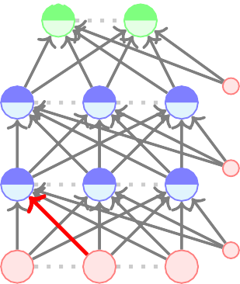
Algorithm:
descent()
Let us focus on this one weight (W₁₁₂).
To learn this weight using SGD we need a
yˆ = f (x)
gradient
a31
t ← 0;
W311
b₃
h21
max iterations ← 1000;
formula for ^{∂L (θ)} .
Initialize θ₀;
while
t++ < max iterations do
∂W112
We will see how to
calculate this.
a21
W211
b₂
h
11
θ_{t+1} ← θ_{t} − η∇θ_{t};
a11
end
W111 W112
b₁
x₁
x₂
x_{d}
CS7015 (Deep Learning): Lecture 4

Slide 25
L (θ)
yˆ = f (x)
First let us take the simple case when we have a deep but thin network.
In this case it is easy to find the derivative by chain rule.
aL1
h21
WL11
∂L (θ) ₌ ∂L (θ) ∂yˆ ∂a_{L11} ∂h₂₁ ∂a₂₁ ∂h₁₁ ∂a₁₁
∂yˆ
∂W111 ∂aL11 ∂h21 ∂a21 ∂h11 ∂a11 ∂W111
a21
h11
∂L (θ) ₌ ∂L (θ) ∂h₁₁
W211
(just compressing the chain rule)
∂h₁₁
∂W111 ∂W111
∂L (θ) ₌ ∂L (θ) ∂h₂₁
∂W211
∂L (θ)
∂h₂₁
∂W211
a11
∂L (θ) ∂a_{L1}
W111
=
∂WL11
∂a_{L1}
∂WL11
x₁
CS7015 (Deep Learning): Lecture 4

Slide 26
Let us see an intuitive explanation of backpropagation before we get into the mathematical details
CS7015 (Deep Learning): Lecture 4

Slide 27
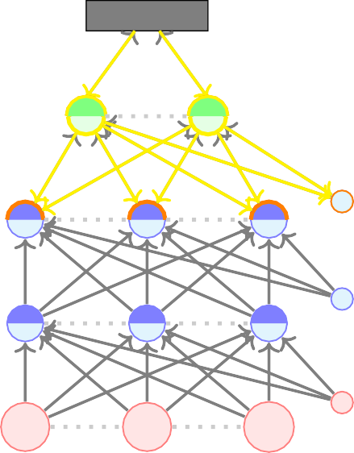
We get a certain loss at the output and we try to figure out who is responsible for this loss
— log yˆ_{l}
So, we talk to the output layer and say “Hey! You are not producing the desired output, better take responsibility”.
The output layer says “Well, I take responsibility for my part but please understand that I am only as the good as the hidden layer and weights below me”. After all . . .
a₃
W₃
b₃
h₂
a₂ h₁
W₂
b₂
f (x) = yˆ = O(W_{L}h_{L−1} + b_{L})
a₁
W₁
b₁
x₁
x₂
x_{n}
CS7015 (Deep Learning): Lecture 4

Slide 28
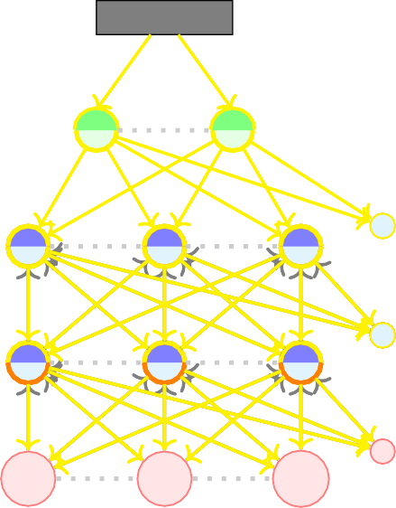
So, we talk to WL, bL and hL and ask them “What is wrong with you?”
— log yˆ_{l}
WL and bL take full responsibility but hL says “Well, please understand that I am only as good as the pre- activation layer”
The pre-activation layer in turn says that I am only as good as the hidden layer and weights below me.
We continue in this manner and realize that the responsibility lies with all the weights and biases (i.e. all the parameters of the model)
But instead of talking to them directly, it is easier to talk to them through the hidden layers and output layers (and this is exactly what the chain rule allows us to do)
a₃
W₃
b₃
h₂
a₂ h₁
W₂
b₂
a₁
W₁
b₁
∂L (θ) ∂L (θ) ∂yˆ ∂a ∂h
∂a ∂h ∂a
=
3 2
2 1 1
∂W111
∂yˆ ∂a3
∂h2 ∂a2
∂h1 ∂a1 ∂W111
x
x
x
` ˛¸ x
` ˛¸ x
` ˛¸ x
` ˛¸ x ` ˛¸ x
1
2
n
Talk to the
Talk to the Talk to the
Talk to the and now
weight directly
output layer previous hidden
previous talk to
layer
hidden layer
the
weights
CS7015 (Deep Learning): Lecture 4

Slide 29
Quantities of interest (roadmap for the remaining part):
Gradient w.r.t. output units Gradient w.r.t. hidden units Gradient w.r.t. weights and biases
∂L (θ)
∂L (θ) ∂yˆ
=
∂a₃ ∂h₂
∂a₂ ∂h₁ ∂a₁
∂W111
∂yˆ ∂a₃
∂h₂ ∂a₂
∂h₁ ∂a₁
∂W111
` ˛¸ x
` ˛¸ x
` ˛¸ x ` ˛¸ x ` ˛¸ x
Talk to the
Talk to the Talk to the
Talk to the and now
weight directly
output layer previous hidden
previous talk to
layer
hidden layer
the
weights
Our focus is on Cross entropy loss and Softmax output.
CS7015 (Deep Learning): Lecture 4

